Slide 1
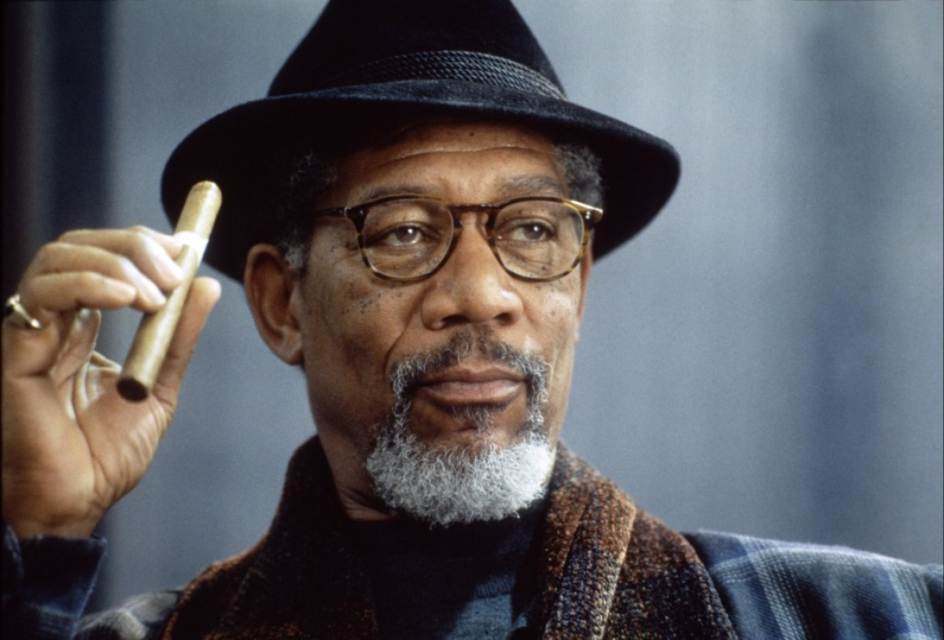
Morgan Freeman

Slide 2
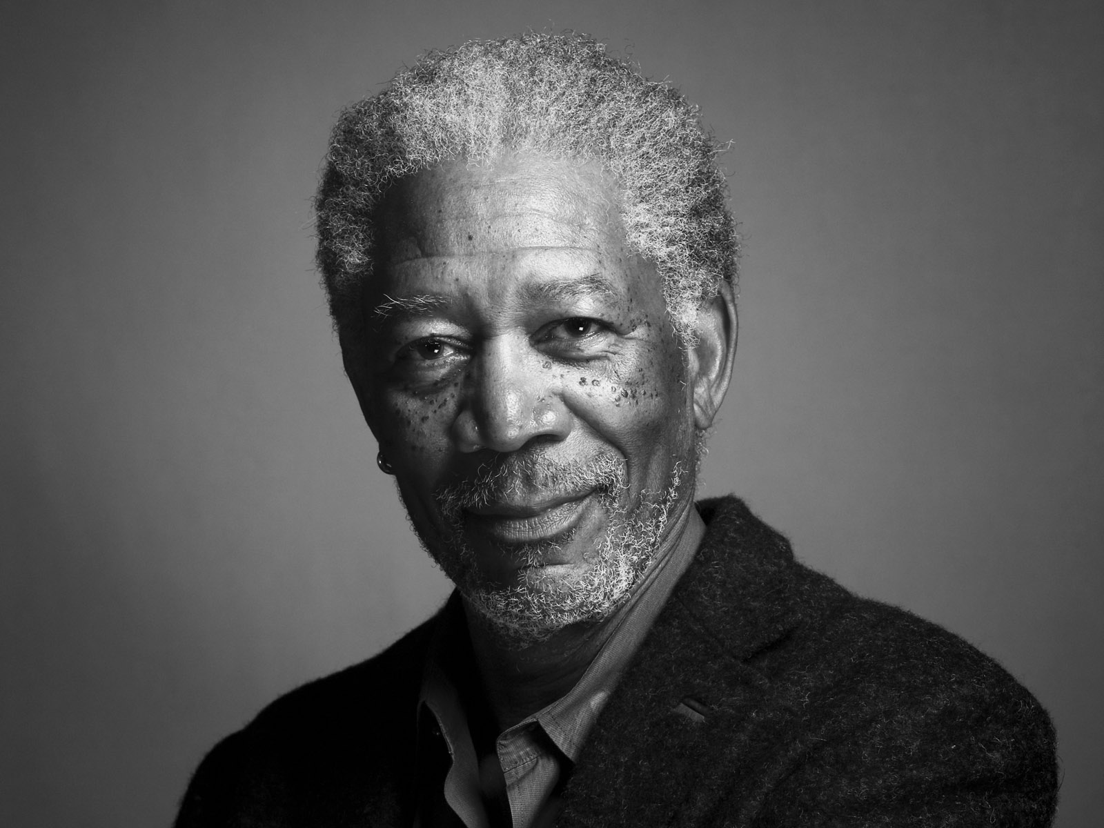
Summary
Personal Life
His career
His Awards

Slide 3
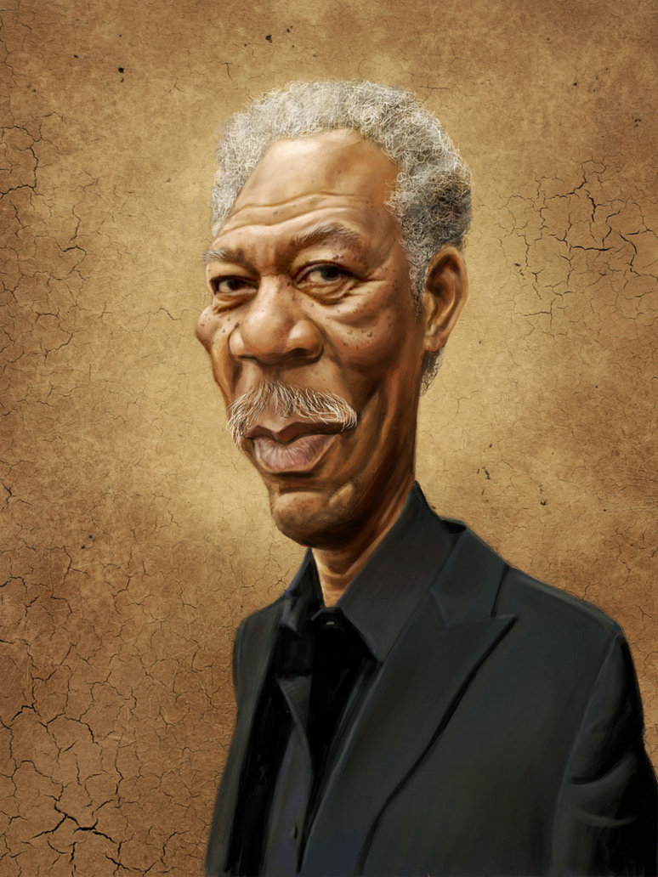
The begining of Freeman
Born the 1st june of 1937
Discovered the theater at the age of 10
Us air Force at the age of 18
1964 : decided to become an actor

Slide 4
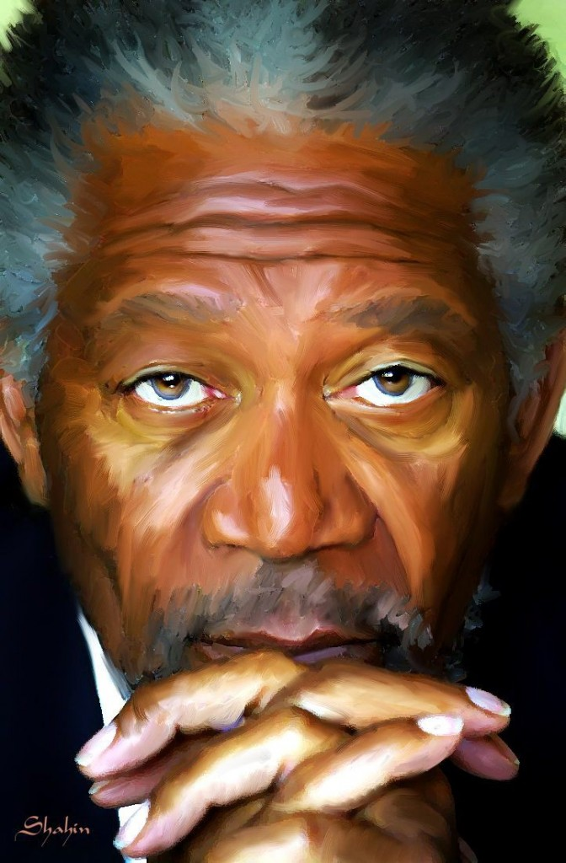
Private Life
1967 : Maried for the first time
1984 : Maried for the second time
2010 : divorced
2013 : reveals his illness

Slide 5
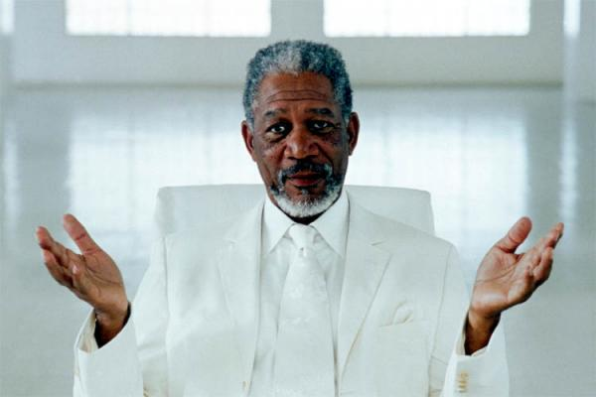
Career
1967 : Broadway and « Hello Dolly »
1987 : the first big success « La rue »
1990 : « Miss Daisy »

Slide 6
Career
1989 : The Glory
1991 : Robin hood, prince of the thieves
1994 : The Shawshank Redemption
1995 : Seven
2004 : Million Dollars Baby
2005-2012 : Batman Trilogy
2009 : Invictus

Slide 7
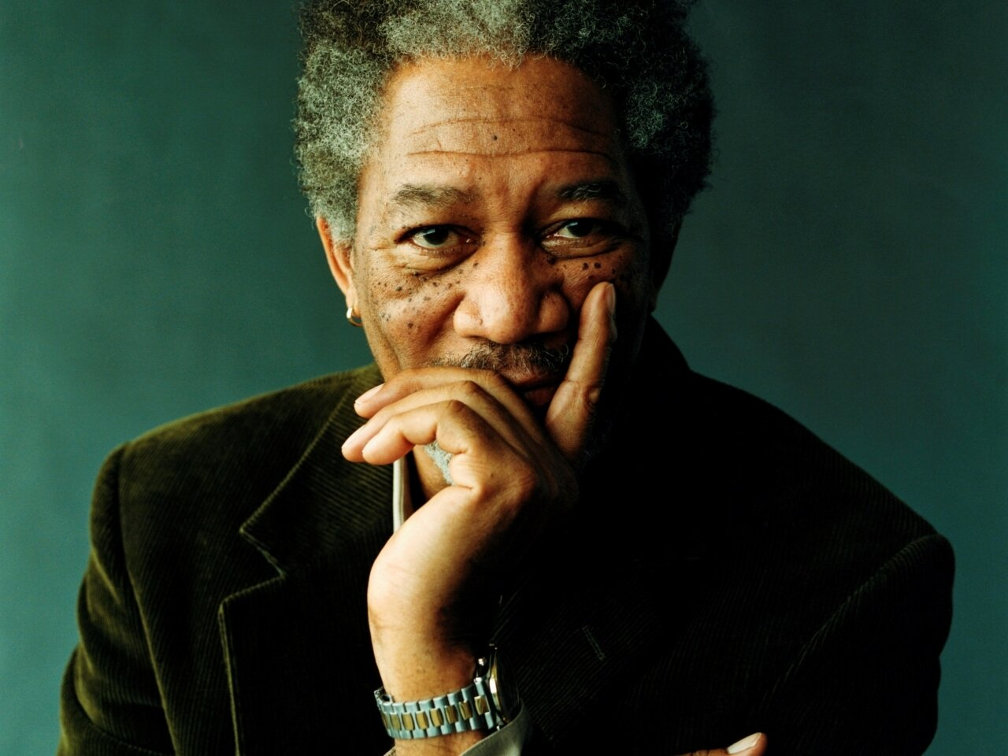
Characteristics of this actor
The embodiment of wisdom
A special voice
Used of secondary role

Slide 8
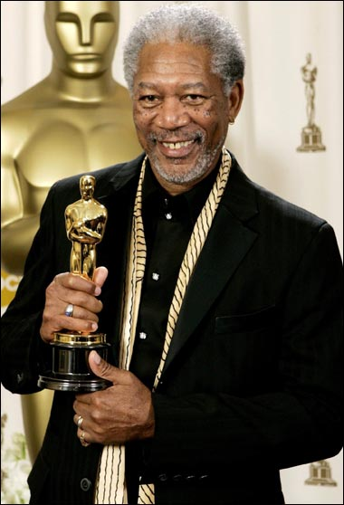
Awards
Morgan Freeman, It is :
4 Oscars
6 Golden Globes
Beloved man

Slide 9
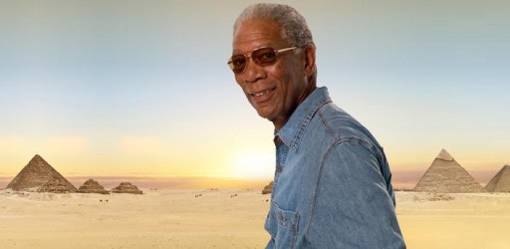
Conclusion

